Slide 1
Post-Burn Pruritus: Thinking Beyond Scratching The Surface
Rajeev B. Ahuja, MS, MCh, DNB, FICS, FACS, FAMS.
Gaurav Gupta, MS, DNB (Plastic Surgery)
Department of Burns & Plastic Surgery,
L. N. Hospital & Maulana Azad Medical College,
New Delhi, India
Notes:
Scratching the surface has two meanings here: one related to scratching the itchy skin, other is regarding the treatment of pruritus which has been non-innovative, just symptomatic , loose and has not been given its due importance.
Hitting the right spot/ bull’s eye/ nailing it is what we have achieved with pregabalin

Slide 2
Pruritus
Punishment for Sins/Misdeeds
“the Lord will afflict you with the boils of Egypt and with tumors, fleeting sores and the itch, from which you cannot be cured”
Deuteronomy (28: 26–28)
Notes:
Pruritus is considered such a misfortune that it’s mentioned in Deuteronomy that even Lord considers it as a punishment for misdeeds

Slide 3
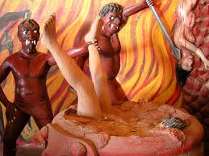
Temple of Hell: Hikkaduwa, Southern Province, Sri Lanka
Notes:
Boiling and burning the sinner in the hell - the favourite past time of the devil;

Slide 4
Basic understanding of pruritus
Philosophy
Receptors
Chemical mediators
Pruritic pathways
Central processing of itch
Peripheral and central sensitization

Slide 5
Understanding pruritus- Philosophy
Scratching aims to remove parasitic pruritogen in skin
Compulsive nature of scratching controlled by
frontal brain areas of reward and decision making
Itch is not skin deep
Secondary skin lesions such as erosions
Itch – scratch – itch cycle
Notes:
The biological purpose of pruritus is to induce scratching in order to remove a pruritogen – a definition likely to have originated when most pruritogens were parasites.
Itch creates a scratch reflex that draws one to the affected skin site. It has been hypothesized that motivational aspects of scratching include the frontal brain areas of reward and decision making. These aspects might therefore contribute to the compulsive nature of itch and scratching
Chronic rubbing, scratching or pinching leads to secondary skin lesions such as erosions, excoriations, crusts, hyperpigmentation or hypopigmentation, lichenification and scars, and causes the release of inflammatory mediators that potentially induce or aggravate pruritic sensations resulting in an itch-scratch-itch cycle. It is clear, therefore, that itching is not skin-deep

Slide 6
Understanding pruritus- Receptors
Free nerve endings
Keratinocytes
Release neuropeptides on damage
Scratching damages the keratinocytes
Specialized subgroup of primary C-nociceptors
Notes:
Free nerve endings of cutaneous sensory C-nerve fibers serve as pruriceptors located in the papillary dermis and epidermis.
Pruritogenic agents may bind specifically to itch receptors on the surface of chemosensitive nerve endings and thereby induce firing of the axons.
However, recent work suggests that the epidermis itself, especially the keratinocytes which form the bulk of the epidermis, constitute the itch receptor. Keratinocytes express a range of neuropeptide mediators and receptors which appear to be involved in pruritus, including opioids, nerve growth factors (NGF), substance P and receptors including vanilloid receptors and proteinase activated receptor type 2 (PAR 2) and voltage-gated ATP channels– all characteristic of neuronal cells. Thus, the epidermis and its associated ramifications of fine intraepidermal C-neuron filaments can be looked upon as the “itch receptor”.
The discovery of a specialized subgroup of primary C-nociceptors has shed new light on peripheral itch mechanisms.[33]When stimulated by a pruritogen, a subset of specialized C‐fibres, originating superficially in the skin, conveys impulses to the dorsal horn of the spinal cord and then via the spinothalamic tract to the thalamus, and on to the somatosensory cortex. These C‐fibres are anatomically identical to those associated with the mediation of pain but functionally distinct.

Slide 7
Understanding pruritus- Chemical mediators
Histamine
PGE₂
Tachykinins, CGRP
Substance P
Opioid peptides
5 hydroxytryptamine (5HT)
Interleukin-2 etc.
Specific inhibitors of these mediators have been shown to alleviate itch.
Notes:
The group of potential chemical mediators is large and is steadily increasing. It contains amines (e.g. histamine, serotonin), proteases (e.g. tryptases), neuropeptides (e.g. substance P (SP), calcitonin gene-related peptide (CGRP), bradykinin), opioids (morphine, beta-, met-, leu-enkephalin), eicosanoids, growth factors and cytokines
Histamine is stored in mast cells and keratinocytes while H₁ and H₂ receptors are present on sensory nerve fibers

Slide 8
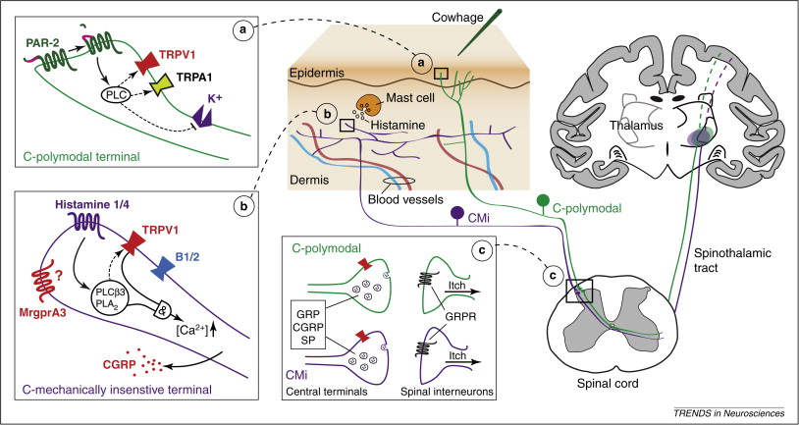
Understanding pruritus- Pathways
Subset of C fibres
Notes:
Aδ and C fibres are involved in the conduction of thermal and pain/itch sensation, while Aβ nerve fibres conduct touch sensation.[30]Neurons that signal pain and irritation exist in both the myelinated and unmyelinated populations, and have been given the name ‘nociceptors’ to indicate their responsiveness to noxious stimuli. Painful sensation evoked by activating myelinated neurons is different in quality (e.g. stinging, pricking) from the dull, aching pain evoked by the recruitment of unmyelinated neurons. [1,11]Nociceptive neurons can be activated by mechanical, thermal and chemical stimuli. They can be sub- grouped on the basis of conducting velocity, mechanical threshold, responsiveness to thermal stimuli and activation by specific chemicals. Their individual responsiveness differs: some respond to single stimuli only, others to several stimuli.[1,11]
This complex system enables the CNS to clearly distinguish between incoming signals from different neurons in quality and localization. Moreover, C-fibres have contacts and maintain cross-talk with other skin cells such as keratinocytes, Langerhans cells, mast cells and inflammatory cells.[30,31] This enables sensory nerves, not only to function as an afferent system, which conducts stimuli from the skin to the CNS, but also as an efferent system, which stimulates cutaneous cells by secreting several kinds of neuropeptides. In addition, sensory sensations can be modified in intensity and quality by this interaction.[30,31]
schematic illustration of multiple anatomical pathways for itch, including transduction at the peripheral terminals in the skin, synaptic transmission in the spinal cord, and central projections to the thalamus. (a) Polymodal C-fibers are activated in the epidermis by the non-histaminergic pruritogen, cowhage. Box A: cowhage releases mucunain, a protease that cleaves and activates the protease-activated receptor 2 (PAR-2) located in the peripheral terminal. Activation of PAR-2 activates phospholipase C (PLC), which in turn sensitizes transient receptor potential vanilloid-1 and ankyrin-1 (TRPV1 and TRPA1) channels.

Slide 9
Understanding pruritus- Central processing
Substantia gelatinosa of spinal cord
Gated mechanism whereby afferent itch traffic can be regulated
Reticular formation
Visual, auditory and other stimuli inhibit itch
Scratching and rubbing the skin
temporary suppression of itching
Notes:
Pruritic stimuli enter the central nervous system (CNS) via unmyelinated C-fibres and possibly Aδ-fibres.[11] The axon enters through the dorsal horn for spinal dermatomes or the trigeminal equivalent of the brainstem for head and neck pruritus. After synaptic connection within the ipsilateral grey column of the spinal cord, processing and control of the transmission occur prior to crossing the midline. After synaptic transmission with the next neuron, the fibre ascends within the contralateral spinothalamic tract.[11,13]
Inhibitory neuronal circuits located in the substantia gelatinosa of the posterior horns of the grey matter of the spinal cord appear to constitute a gated mechanism whereby afferent itch traffic can be regulated.[11] In this scheme, increased tone in descending pathways originating in the reticular formation of the periaqueductal grey results from visual, auditory and other stimuli. The result is the activation of inhibitory neuronal circuits leading to closure of the gated mechanism and diminished itch traffic. Thus, patients frequently point out that their itch is less troublesome during daytime working hours – when engagement of these stimuli is maximized, than in the evening when sensory input is diminished. Pruritus is also the result of an imbalance between opioid actions on central µ- and κ-receptors, the former increasing and the latter diminishing itch – probably due to their respective inhibitory and activating actions on the gated mechanism.[32]
Scratching and rubbing the skin inhibits itch. These activities stimulate the myelinated A neurons via low threshold mechanoreceptors, which excite presynaptic and postsynaptic mechanisms to inhibit neuronal circuits in the grey matter of the spinal cord, and lead to temporary suppression of itching.[37] Scratching also activates nociceptors, which also reduces itch via the spine, since pain inhibits itch

Slide 10
Understanding pruritus- Peripheral sensitization
Response to external stimuli is facilitated and enhanced
Trophic factors (nerve growth factor)
Persistently increased neuronal sensitivity
Increased intradermal nerve fiber density and neurotrophin levels in chronic patients
Non pruritic stimuli stimulates pruritic receptors
(punctate hyperalgesia-punctate hyperkinesis)
Notes:
Inflammatory mediators such as bradykinin, serotonin and interleukins may not only be peripheral mediators of itch but also have been demonstrated to acutely sensitize nociceptors so that their responses to external stimulation is facilitated and enhanced.
In addition, regulation of gene expression induced by trophic factors, such as nerve growth factor, has been shown to play a major role in persistently increased neuronal sensitivity. [13]
Trophic factors also initiate nerve fiber sprouting and increased intradermal nerve fiber density and neurotrophin levels have been found in patients with chronic pruritus also may contribute to the sensitization of nociceptors.

Slide 11
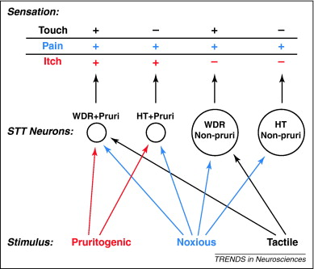
Notes:
A simple model of somatosensory coding for itch, pain and touch via functionally distinct polymodal spinal neurons. Bottom: the skin is exposed to various stimuli: pruritogenic, noxious and tactile. These stimuli activate different subpopulations of spinothalamic tract (STT) neurons. Middle: STT neurons are either pruriceptive (pruri) or not-pruriceptive (non-pruri) and either of the wide dynamic range (WDR) or high-threshold (HT) types. The smaller subpopulation of STT neurons that are pruriceptive are represented by smaller circles, and the larger population of STT neurons that are nociceptive (non-pruriceptive) are represented by larger circles. The output from selective activation of these four types of neurons could distinctively encode touch, pain and itch. Tactile stimuli activate WDR, but not HT neurons. Noxious stimuli activate all four types of neurons. Itch-producing stimuli activate only the pruriceptive subpopulation of neurons. Top: when only the pruriceptive STT neurons are activated (i.e. in the absence of activation of the other nociceptive STT neurons) then itch is signaled. Pruriceptive neurons can also contribute to tactile and nociceptive processing but, without complementary activity in the nociceptive-type neurons, activation of pruriceptive STT neurons produces itch. Thus, the absence of activation of specific subpopulations of STT neurons is hypothesized to be important in transmitting specific sensory information to the brain.

Slide 12
Understanding pruritus- Central sensitization
Increased excitability of neurons
Reduction in inhibitory transmission
Loss of inhibitory neurons
Stimulation of nearby sensory neurons will
stimulate pruritic neurons (allodynia-allokinesis )
Notes:
Many features of central sensitization resemble those that are responsible for memory.
Central sensitization is produced not only by increased excitability
but also by a reduction in inhibitory transmission due to reduced synthesis or action of inhibitory transmitters and to a loss of inhibitory neurons, which may produce persistent enhancement of sensitivity. [38]
Itch can be evoked in patients even by noxious stimuli that should normally be perceived as painful and should suppress itch, indicating a central mechanism. The similarity of central sensitization for pain to mechanically induced itch sensation in the vicinity of an itching stimulus has been documented. This has led to corresponding terms also for central sensitization for itch (allodynia-alloknesis and punctate hyperalgesia-punctate hyperknesis)

Slide 13
Measuring pruritus severity
Visual analogue scale (VAS)
Eppendorf Itch Questionnaire
Modified McGill Pain Questionnaire
Worcester Itch Index
5-D itch scale
Notes:
The visual analogue scale (VAS) is the most common example in pruritus research.[2,3,4] A continuous scale is a line of defined length (in most studies 100 mm) with descriptive anchors at the extremes, e.g. “no pruritus” and “pruritus as bad as it could be”. Subjects can describe the itch sensation precisely without limitation to a few discrete categories, thereby providing continuous data for analysis. This may represent the most sensitive approach to measuring pruritus intensity.[1]
Questionnaires
The Worcester Itch Index was developed at the University of Massachusetts at Worcester.[1]
A questionnaire for uremic patients and other forms of pruritus is based on the short form of the McGill Pain Questionnaire. A modified form of this questionnaire has been used for evaluating patients with psoriasis, chronic idiopathic urticaria and atopic dermatitis and found to be reliable and reproducible.[1,41]
The Eppendorf Itch Questionnaire was developed in cooperation between dermatology and neurophysiology as a modified McGill Pain Questionnaire. It is informative in describing pruritus but does not evaluate other important characteristics, such as the effect of for example daily habits, physical activities on pruritus or antipruritic.[42]
The 5-D itch scale was developed as a brief but multidimensional questionnaire designed to be useful as an outcome measure in clinical trials

Slide 14
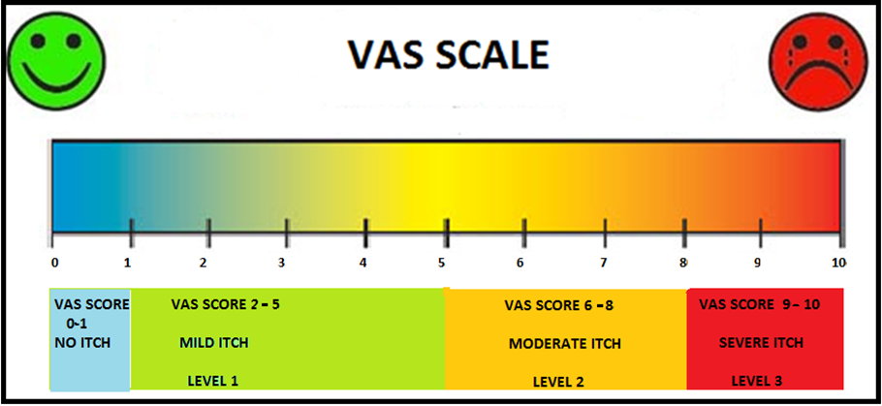
Modified VAS scale

Slide 15
Prevalence & characteristics of post-burn pruritus
Itching during the first two weeks post-burn
Most severe immediately after wound closure
Up to two years following burns
Prevalence : 80 to 100%
Night > day
Legs > arms > face
Notes:
Most burn patients complain of some itching and it continues to remain a problem for a significant percentage of individuals for a period up to two years following burns. [44]The prevalence of pruritus in individuals with burns has been documented between 16-87% and this percentage increases in the pediatric age group to 100%. [7]Women were reported to have higher itch scores in comparison to men. [7]Itching increases during the first two weeks post-burn and is most severe immediately after wound closure. The remodeling of the skin continues for an extended period of time, and pruritus may sometime persist for years together. [6,44]Acute itching affects the majority of the patients, comprising those with partial- or full-thickness burns, but tends to be less severe in patients with full thickness burns owing to nerve damage. [7,45]Chronic itching appeared to be more likely in persons with deep dermal injury and may be characterized by lower intensity of complaints. Van Loey (2008) reported an incidence of 67% with mild to moderate itching complaints at 2 years in post-burn patients. [7]Willebrand et al (2004) found burn related pruritus in more than half of the previously burnt patients on an average 9 years after the injury. [6]It is most pronounced during the night and in patients at bed rest. [44]The most common site is the legs followed by the arms and then the face. [2] It is accentuated by heat and activity, and anything that increases body temperature. Since histamine release can lead to itch and also increasedlocal blood flow, there may a relationship. However, it remains unclear how heat releases histamine. [46]
Pruritus is particularly problematic in the pediatric population, because it may impede recovery if scratching leads to opening up of the previously healed skin, bleeding and, therefore, increased chances of infection in an already immunocompromised patient.[47]. Furthermore, patient may become agitated and may have difficulty in sleeping, which may further impede their healing.[47] It may affect their ability to concentrate, and thereby their ability to function well in everyday life.[6]

Slide 16
Prolonged Wound Healing
Deep Burns
Conservative Methods
Infection
Mechanism
Increased Collagen Deposition
Persistent Itch
Increase Histamine Release
Notes:
Pruritus after burn injury has been associated with some injury-related factors, such as the extent of body surface area burned, time until wound closure, and the localization of the burn, but the underlying mechanism of pruritus is not well known.[2] . Recent ﬁndings regarding general pruritus suggest that there are itch-speciﬁc neurons that are sensitized by the release of histamine.[12] In the early phases of recovery after a burn injury, pruritus may be largely explained by the release of histamine, as it is associated with excessive or prolonged wound healing processes, for instance during infection and in hypertrophic scarring.[6,48] In a setup like ours where due to overwhelming number of acute burn patients, most of the patients are treated conservatively with dressings, wound healing takes a protracted course, collagen synthesis occurs over a longer period of time, and therefore, pruritus continues to be a challenging problem.[49]

Slide 17
Current Therapy of Post-burn Pruritus
Interventions on peripheral aspects of pruritus
Interventions on the central pruritic pathway

Slide 18
Interventions acting on peripheral aspects of pruritus
Non- pharmacologic
Skin hydration
Compression
Massage
Silicone gel sheets
Lasers
Cooling of the wound
Colloidal oatmeal
Pharmacologic
Antihistamines
Doxepin
Local anesthetic creams
Ondansetron

Slide 19
Interventions acting on peripheral aspects of pruritus
Non- pharmacologic Skin hydration
Dry skin itself leads to pruritus.
Patients should avoid hot baths
Use mild soaps.
Apply bland emollients several times a day
preferably after bath to seal in the moisture.

Slide 20
Interventions acting on peripheral aspects of pruritus
Non- pharmacologic Compression and massage
Help in maturation of scars
Control collagen synthesis
Limiting the supply of blood, oxygen, and nutrients
Lower the fibroblasts activity
Encourage realignment of collagen bundles
Collagenase secretion

Slide 21
Interventions acting on peripheral aspects of pruritus
Non- pharmacologic Silicon gel sheets / creams
Reduces mast cell count

Slide 22
Interventions acting on peripheral aspects of pruritus
Non- pharmacologic Lasers
Pulsed dye laser (PDL)
decreases scar erythema and thickness
Allison KP, Kiernan MN, Waters RA, Clement RM. Pulsed dye laser treatment of burn scars. Alleviation or irritation? Burns. 2003;29(3):207-13.
In 38 patients assessed the value of the 585-nm flash lamp-pumped dye laser on scar tenderness, surface texture, and pruritus with three treatments at monthly intervals. Pruritus improved at 1 month and remained improved at 6 and 12 months (Pp< 0.0001).
Notes:
The pulsed dye laser (PDL) has emerged as a successful alternative to excision in patients with hypertrophic burn scars. Multiple studies have shown its ability to decrease scar erythema and thickness while significantly decreasing pruritus and improving the cosmetic appearance of the scar. [60,61,62]. The rationale used was that the blood vessel diameters in hypertrophic scar tissue are much smaller than the vessels in port wine stains for which this laser was designed to treat, therefore, by decreasing the pulse width, more vascular specific damage in the scar may be possible.[61]
One study involving 38 adult and pediatric patients with symptomatic burns scars assessed the value of the 585-nm flashlamp-pumped dye laser on scar tenderness, surface texture, and pruritus with three treatments at monthly intervals. Pruritus visual analog scale (VAS) (0-10) improved at 1 month and remained improved at 6 and 12 months (P < 0.0001).[61]
Similar results were replicated in another study using 585-nm pulsed dye laser 49 and with a 400-mW 670 nm softlaser approach. The mechanism of symptomatic relief in these studies might be related to the effect of laser on the microcirculation and pruritogenic chemicals found in scar tissue

Slide 23
Interventions acting on peripheral aspects of pruritus
Pharmacologic Antihistaminics
Mainstay of anti-pruritic therapy for decades
First-generation H₁-antihistamines
Sedating
Bind to histaminic, muscarinic, alpha-adrenergic, and serotonergic receptors
Chlorpheniramine, pheniramine, hydroxyzine
Second-generation H₁-antihistamines
Relatively non-sedating
Minimal activity at nonhistaminic receptors
Cetirizine, levo-cetrizine
Notes:
first-generation H₁-antihistamines, which are sedating, as compared with second-generation compounds, which are relatively non-sedating, is now more commonly used. First-generation antihistamines (including chlorpheniramine, pheniramine, diphenhydramine, hydroxyzine, and cyproheptidine) bind to histaminic, muscarinic, alpha-adrenergic, and serotonergic receptors, whereas second-generation compounds have minimal activity at nonhistaminic receptors. The latter have reduced central nervous system penetration, a more favorable side effect profile and longer duration of action

Slide 24
Interventions acting on peripheral aspects of pruritus
Pharmacologic Antihistaminics
Drawbacks
Only address peripheral aspect of pruritic pathway
Reversible competitive antagonists of H1 receptor
Do not prevent histamine release or bind to the histamine that has already been released.
No mechanism to inhibit central and peripheral sensitization
Notes:
Antihistamines are reversible competitive antagonists of histamine at H1 receptor sites. They
do not prevent histamine release or bind to the histamine that has already been released.
The H1 receptor blockade results in decreased vascular permeability, reduction of pruritus
and relaxation of smooth muscle in the respiratory and gastrointestinal tracts.(1) They are
clinically efficacious for alleviating symptoms of allergic rhinitis that are attributed to the
early-phase reaction, such as rhinorrhea, pruritus, and sneezing. However, they are less
efficacious in controlling nasal congestion, which is related to the late-phase reaction.
Second or third generation antihistamines have entered the market that demonstrated
improved peripheral H1 receptor selectivity, decreased lipophilicity in order to minimize CNS
side effects and additional antiallergic properties apart from histamine antagonism. They
interfere with mediator release from mast cells either by inhibiting calcium ion influx across
mast cell/basophil plasma membrane or by inhibiting intracellular calcium ion release within
the cells. They may also inhibit the late-phase allergic reaction by acting on leukotrienes or
prostaglandins, or by producing an anti-platelet activating factor effect

Slide 25
Interventions acting on central aspects of pruritus
Transcutaneous electrical nerve stimulation (TENS)
Gabapentin
Pregabalin

Slide 26
Emergence of Gabapentin and Pregabalin and their role in management of post-burn pruritus

Slide 27
The story so far…….
Mendham JE. Burns 2004; 30:851–853.
Introduced gabapentin for the treatment of itching.
All children responded with in 24 hrs with itch relief.
Goutos I, Eldardiri M, Khan AA, Dziewulski P, Richardson PM
J Burn Care Res 2010; 31(1):57-63.
Compares two antipruritic protocols involving a
combination of moisturizers, antihistaminics and gabapentin.
Response to gabapentin as monotherapy or with antihistamines
was higher than antihistaminics alone.

Slide 28

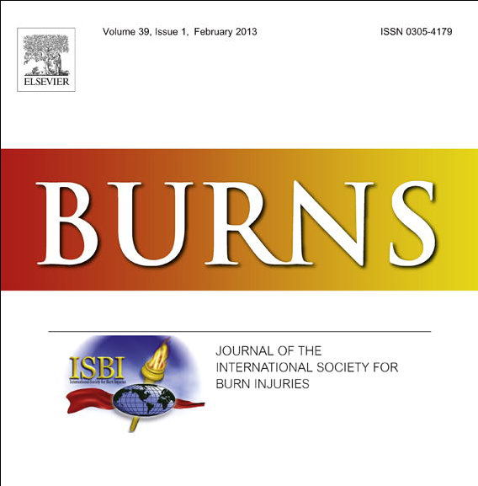
A comparative analysis of cetirizine, gabapentin and their combination in the relief of post-burn pruritus.
Rajeev B. Ahuja *, Rajat Gupta, Gaurav Gupta, Prabhat Shrivastava
First randomized controlled trial.
Gabapentin is significantly more effective than cetirizine in relieving post burn itch, as monotherapy agent, regardless of the initial VAS scores.
The onset of action with gabapentin is dramatic, showing 74% decrease in mean VAS scores by day 3 and 95% decrease by day 28.
Results of combination therapy are exactly comparable to treatment with gabapentin alone. There being no additional advantage of a combination therapy.

Slide 29

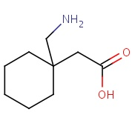
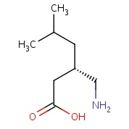
A four arm, double blind, randomized and placebo controlled study of pregabalin in the management of
post-burn pruritus.
Rajeev B. Ahuja *, Gaurav K. Gupta
Gabapentin and pregabalin are structural analogues
synthesized to mimic the chemical structure of the neurotransmitter gamma-aminobutyric acid (GABA)
Gabapentin
Pregabalin

Slide 30
Why Pregabalin ?
Similar mechanism of action
Inhibition of calcium currents via high-voltage-activated channels containing the α2δ-1 subunit.
Similar indications
Anti-epileptic agents
Neuropathic pain
Diabetic neuropathy
Post-herpetic neuralgia
Fibromyalgia

Slide 31
Why Pregabalin ?
Favorable pharmaco-kinetic & pharmaco-dynamic profile.
Greater pain relief.
Fewer side effects reported than gabapentin.
More cost effective therapy than gabapentin.
Used in uremic pruritus & cetuximab related itch.
No study in relieving post-burn pruritus.

Slide 32
Conclusions
This study unequivocally establishes the superiority of α2δ ligands in providing complete relief from post-burn itch
Massage alone:
Only (partially) effective in mild itch.
But should be prescribed to all patients.
Antihistamines + Massage:
Only effective in mild pruritus
Partial relief in moderate-severe pruritus

Slide 33
Conclusions
Pregabalin + Massage:
Treatment of choice in all severities of post-burn pruritus
Combination therapy:
Offers no real advantage

Slide 34
Advantages of α2δ ligands in post-burn pruritus
Act centrally-block the final pathway for pain processing
More efficacious
Less sedation
Offers anxiolysis and mood elevation
Better nocturnal sleep pattern
Relieves post- traumatic stress disorder

Slide 35
Recommendations
All patients of post-burn pruritus should be treated
with pregabalin and massage.
Pregabalin dosage
Mild itch: 75mg tid
Moderate itch: 150mg bd
Severe itch: 150mg bd - 150mg tid

Slide 36
Conflict of Interest
None of the authors has any conflict of interest with
the drugs tested, or their manufacturers and distributors.

Slide 37
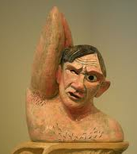

Slide 38

THANK YOU….

